Slide 1
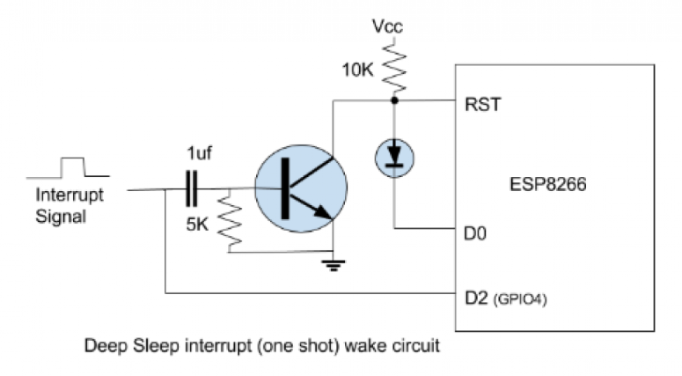
BURGLAR DETECTION USING PIR
SLEEP MODE
As a part of Power consumption the deep sleep mode feature in ESP8266 is implemented. The module wakes with an interrupt (motion) , sends its MQTT response and goes back to sleep.
During the normal mode the PIR /motion mode the ESP is consuming 3.3-4v and 80mA of current.
In the deep sleep mode the current consumption is 8mA(substantial drop)

Slide 2
Battery consumption (Estimated from our approx. cal)
From the data collected the estimated motions in a hour is around 80 which varies from person to person and timings.
Motion in an hour = 80
Current consumption by ESP when there is motion = 80mA
Time taken by ESP to wake up publish the message to broker and then sleep during a motion = 2.5sec (average)
In a hour = 80*2.5 = 200sec for a motion
Remaining 3400 sec in a hour is in deep sleep mode
200sec * 80mA + 3400sec * 8mA = 12mAh in an hour

Slide 3
Battery capacity of our battery setup = 2900mAh
Hence the battery would last for around =
Output Efficiency of Battery = 0.80 * 2900 = 2320 mAh
2310 mAh/ 12mAh = 193 hours = 8days
The battery should approx. last for 8 days if there is 80 motion in average in an hour.

Slide 4
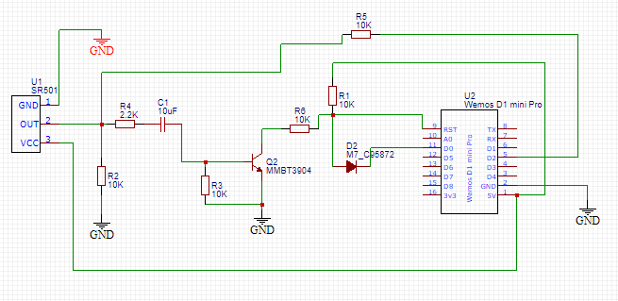
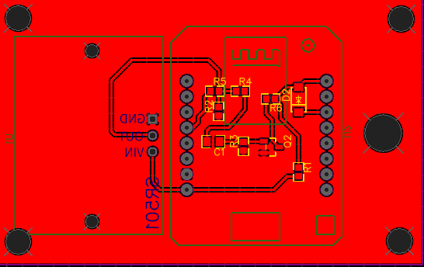
PCB REDESIGNED WITH DEEP SLEEP CIRCUIT INCORPORATED

Slide 5
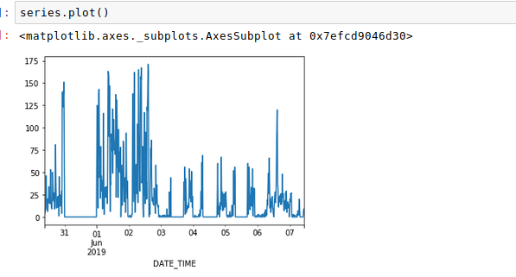
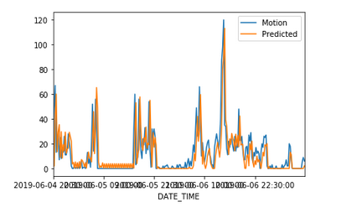

LSTM WITH UNIVARIANT TIME FORECASTING
DATA
PREDICTION

